Slide 1
Cortex-M3 Programming

Slide 2
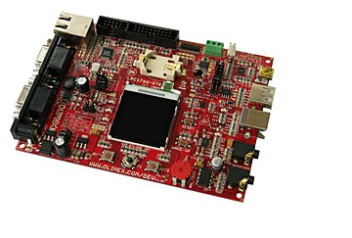
Chapter 10 in the reference book

Slide 3
10.1 Overview
10.1.1 Using Assembly
It is possible to develop the whole application in assembly language.
Pros:
The best optimization (performance), e.g., timing-critical routines
Smaller program size, e.g., tight memory requirements
Access to the underlying hardware when needed, e.g., special registers
Cons:
Long development time
Easy to make mistakes
Hard to handle complex data structures

Slide 4
10.1.2 Using C
C has the advantage of being portable and easier for implementing complex operations.
Use of the C language can often speed up application development
When low-level system control is required include assembly code, called inline assembler.
Example: an assembly function in C program
__asm void SetFaultMask(unsigned int new_value)
{
// Assembly code here
MSR FAULTMASK, new_value // Write new value to FAULTMASK
BX LR // Return to calling program
}

Slide 5
10.2 Interface between Assembly and C
In various situations, assembly code and the C program interact.
When embedded assembly (or inline assembler, in the case of the GNU tool chain) is used in C program code
When C program code calls a function or subroutine implemented in assembler in a separate file
When an assembly program calls a C function or subroutine
It is important to understand how parameters and return results are passed between the caller and callee programs using registers R0-R3 and R12.

Slide 6
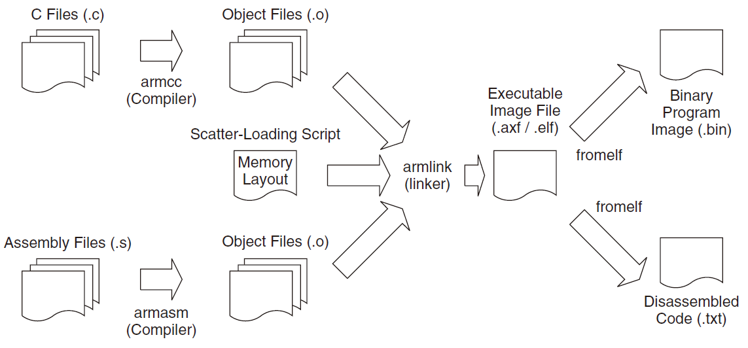
10.3 A Typical Development Flow
For the most basic uses, you will need an assembler, a C compiler, a linker, and binary file generation utilities.
Aside from these basic tools, most development tool kits also contain a large number of utilities, including an Integrated Development Environment (IDE) and debuggers.

Slide 7
10.4 An Assembly Program Example
STACK_TOP EQU 0x20002000 ; constant for SP starting value
AREA | Header Code|, CODE
DCD STACK_TOP ; SP initial value
DCD Start ; Reset vector
ENTRY
Start ; Start of main program
; initialize registers
MOV r0, #10 ; Starting loop counter value
MOV r1, #0 ; starting result
; Calculated 10+9+8+...+1
loop
ADD r1, r0 ; R1 = R1 + R0
SUBS r0, #1 ; Decrement R0, update fl ag (“S” suffi x)
BNE loop ; If result not zero jump to loop
; Result is now in R1
LDR r0,=MyData1 ; Put address of MyData1 into R0
STR r1,[r0] ; Store the result in MyData1
deadloop
B deadloop ; Infi nite loop
AREA | Header Data|, DATA
ALIGN 4
MyData1 DCD 0 ; Destination of calculation result
MyData2 DCD 0
END ; End of file

Slide 8
Assuming you are using ARM tools, this program can be assembled using
$> armasm --cpu cortex-m3 -o test1.o test1.s
Use a linker to create an executable image (ELF)
$> armlink --rw_base 0x20000000 --ro_base 0x0 --map -o test1.elf test1.o
In the example, during the linking stage, the linker will put the DATA region into read/write memory, so the address for MyData1 will be 0x20000000.
We need to create the binary image
$> fromelf --bin --output test1.bin test1.elf
You can then load your ELF image or binary image into your hardware or instruction set simulator for testing

Slide 9
10.4 Using Exclusive Access for Semaphores
Exclusive access instructions are used for semaphore operations to make sure that a resource is used by only one task.
Example:
When two processes try to lock a semaphore at the same time (read the semaphore first, if it’s not locked, then write 1 to lock the semaphore), it is possible that both tasks believe that they have exclusive access to the resource.
Use exclusive accesses: LDREX, STREX, CLREX

Slide 10
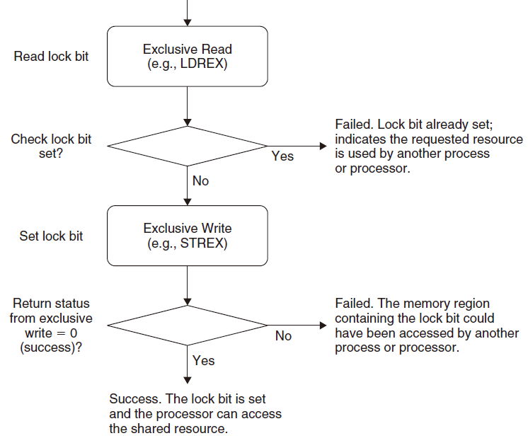
Using Exclusive Access for Semaphore Operations

Slide 11
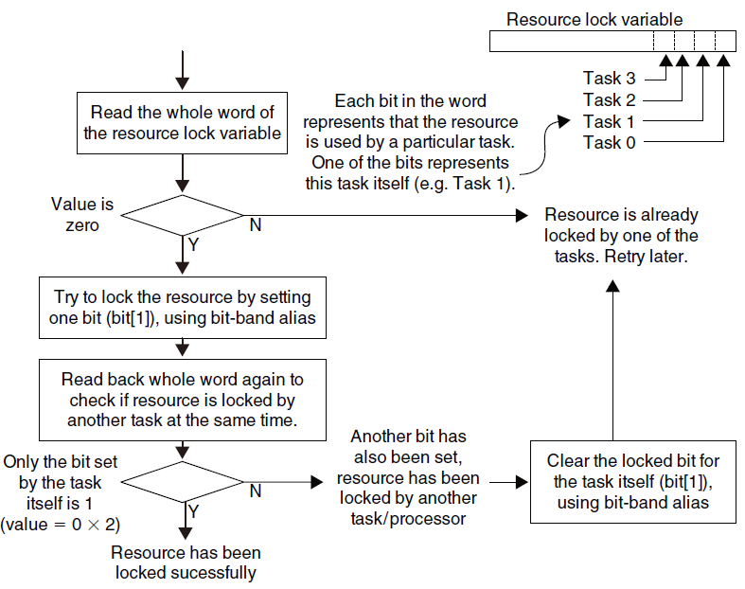
10.5 Using Bit-Band for Semaphores
It is possible to use the bit-band feature to carry semaphore operations, Since the bit-band alias writes are locked READ-MODIFY-WRITE transfers.

